Slide 1
Connector Base Wiring

Slide 2
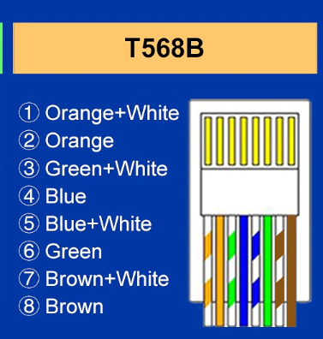
RJ45 patch cables are T568B convention
1
3
2
1
3
G/stripe = V2
Blue = V1
Blue/stripe = I2
Green = I1
2
1
1
3
2
3
2
Souriau-Sunbank by Eaton
JMX series 12 conductor plug pinout
V2 V1 I2 I1

Slide 3
QC
Verified every single connection to not only be isolated, but also connected to its appropriate wire (2x)
Placed labels on each wire to say which chamber it is and which wire
Accidentally cut one RJ45 off and reattached and confirmed connection. Blue might be shaky though
Exposed 2-3mm of silver on each electrode for bleach treatment to make into AgCl electrodes
2-3 Ohms is average resistance measured between electrode and RJ45 terminal

